Slide 1
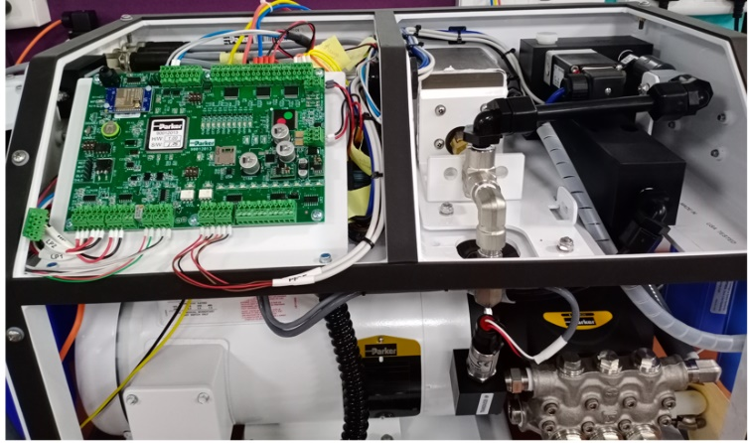
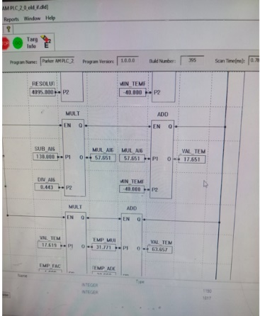
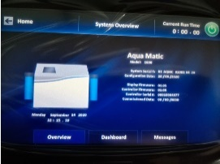
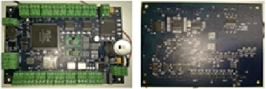
Division: WPD
Sea Water Purifier Controller – HMI Design & Development – 1 of 2
Scope
Reverse engineering of existing controller board. Outcomes are
Schematic
BOM
Design a new controller board to replace existing controller board.
Development of PLC code for water maker.
Development of screens for 7” and 4.8” HMI displays.
System testing at offshore lab.
Challenges
No reference documentation available (i.e., not available any kind of documents like schematics, BOM) for existing controller board.
Environment
EZ Ladder
Ladder Logic
Functional Blocks
Structured Text
Easy Builder Pro
NMEA2000
CAN Sniff
Benefits and Improvements
Solution
Hardware, firmware completely owned by POEC.
New controller board size is decreased by 50%.
PLC code update in the field made easy using SD Card.
End to End development of controller board.

